Slide 1
Transport for London
Visualization of Live Transportation Data
James Black
Ramsey Magana
Aniruddh Nautiyal
Rick Ung

Slide 2
Project Goal
Purpose: Our group is most interested in exploring how to process and visualize streaming data. Our goal is to use Transport for London’s (TfL) live streaming transportation data and create a live representation of their transportation network.
Source: https://tfl.gov.uk/info-for/open-data-users/our-open-data
Proposed Architecture: Kappa architecture for processing streaming data, likely pushed to Tableau for final graphical depiction

Slide 3
Available Data
The following datasets are available through TfL’s API:
Air quality
General (station locations, station facilities, journey planning timetables)
Tube (departure boards, line status, station status)
Bus, coach, river (live bus and river bus arrivals, stop locations, routes)
Roads (live traffic disruptions, live roadside message signs, live CCTV)
Cycling
Walking (walking times between adjacent stations in Zones 1-3)
Network Statistics (busiest times, rider counts, Oyster card journeys)
We look to possibly combine more than one data sources to serve as the final dataset for the project.

Slide 4
Background
Motivation:
Live feed dashboard for commuters
Identifying congestion routes
Exploratory analysis of commute patterns
Challenges expected:
Combining datasets
Common attribute for joining
Common resolution e.g. based on time
Visualization
Tooling complexity (beyond Tableau, e.g. D3)

Slide 5
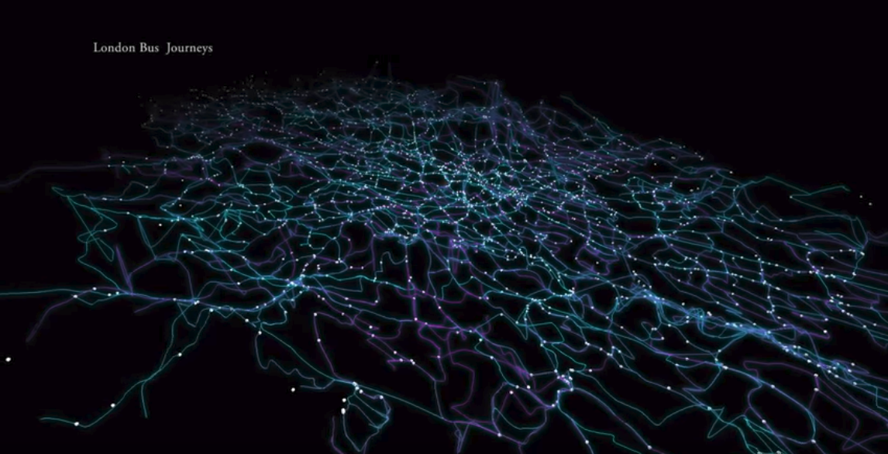
Previous Example
Streaming Processing
Method: Visualization of live TfL bus positions
Source: https://www.youtube.com/watch?v=FKs7DND1kkg

Slide 6
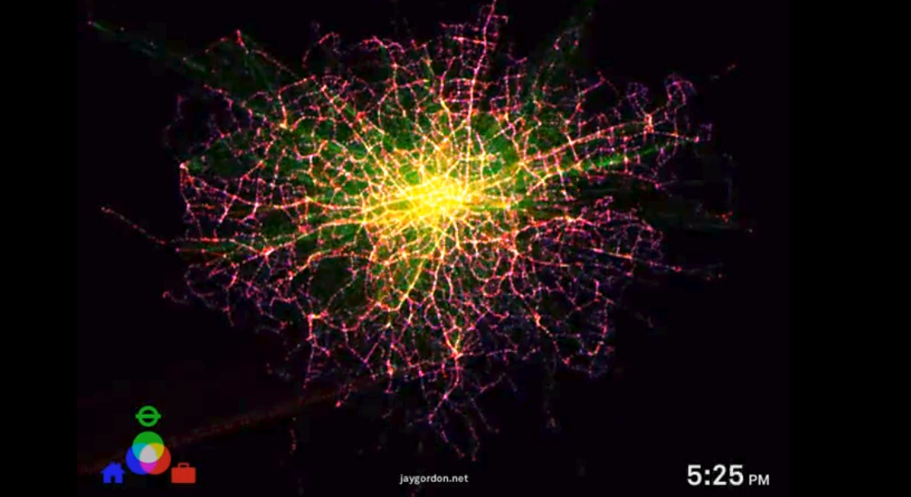
Previous Example
Batch Processing
Method: Visualization of batch processed daily travel histories
Source: https://www.youtube.com/watch?v=4FrnF2HlBGg

